Slide 1
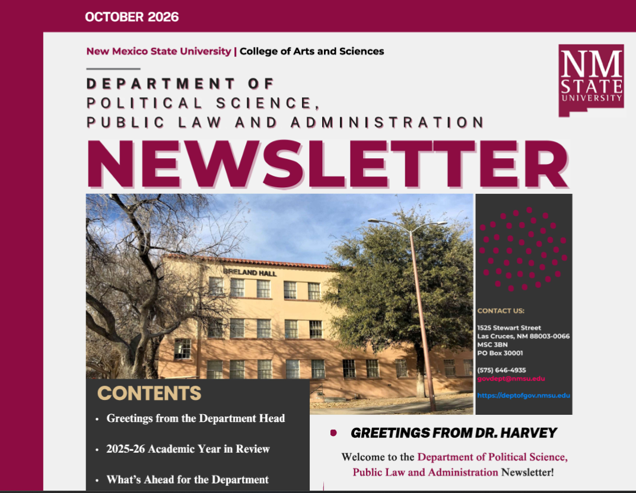
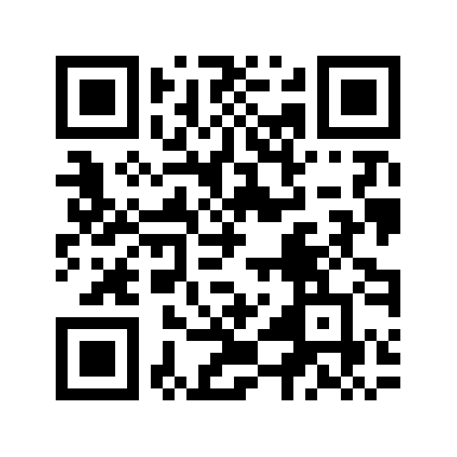
Department of Political Science, Public Law and Administration
CURCA Research Showcase, October 22, 2026
New Research in Democracy, Security, and Human Rights

Slide 2
Research skills for successful careers in public service
Attorneys, Public Defenders
Elected
Officials
Public administrators
Social Studies Teachers
University professors
Researchers and policy analysts
Community advocates and non-profits
And more….
Life-long career value of strong research skills
Ethical and collaborative research to effectively address societal needs
Median salary: $67k (based on 200 of our graduates reporting salaries in 2010-25)

Slide 3
Develop your research skills in Spring 2027
POLS 300 Political Research Skills (Dr. Conner, MW 12.00-1.15)
POLS 359 American Public Polling (Dr. Gomez, TR 12.00-1.15)
All upper-division POLS courses require research papers, presentations, or simulations
Sundt Honors Seminar; HONS 470V (Dr. Hirschauer, TR 10.30-11.45)
Honors Thesis in Politics: Ask for one of our faculty mentors
TRIO McNair Program (towards a Ph.D): https://honors.nmsu.edu/mcnair-scholars.html
Present at URCAS

Slide 4
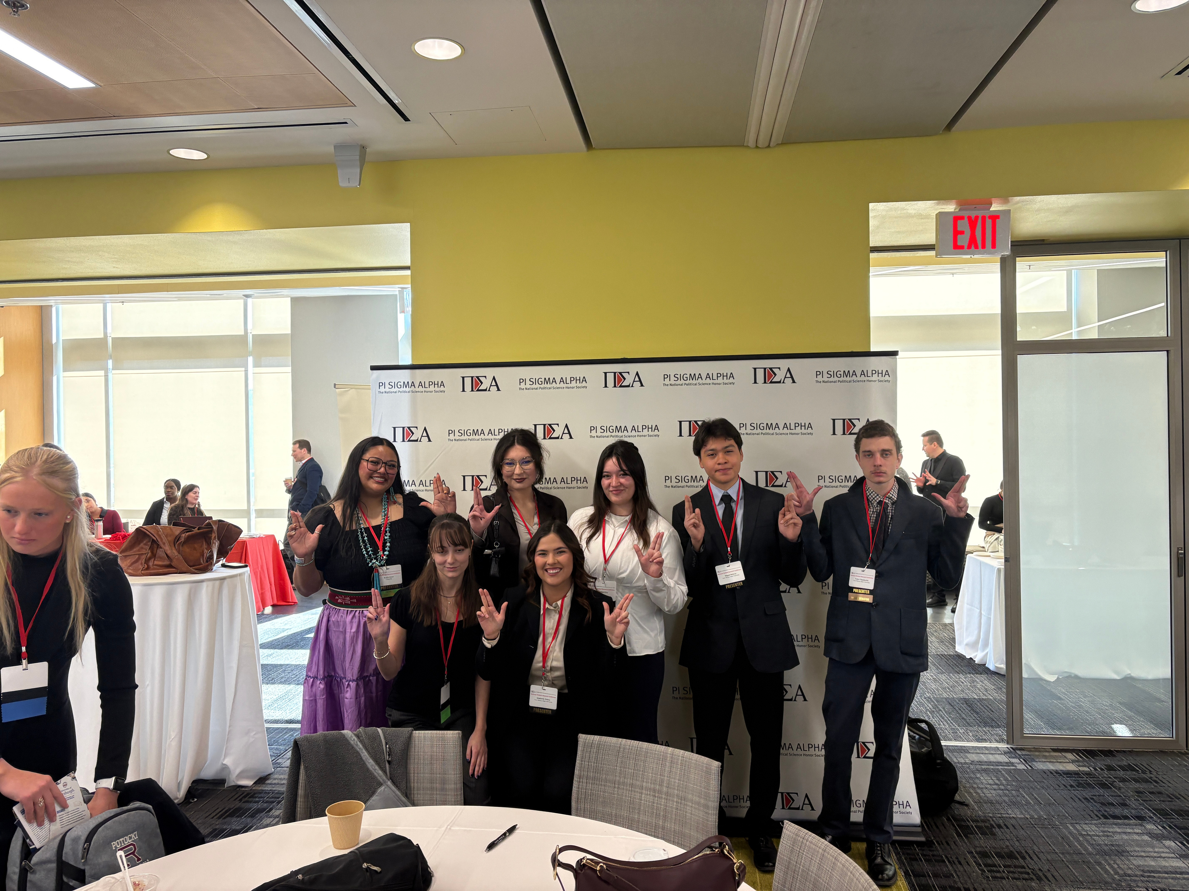
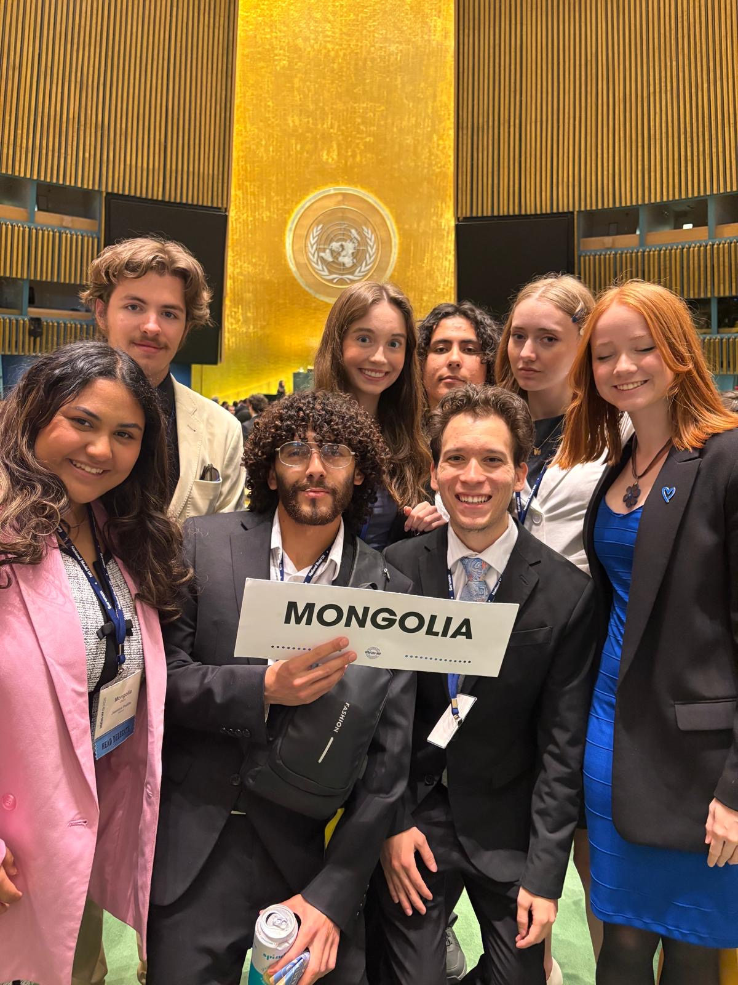
Student clubs and research experience
Pi Sigma Alpha National Political Science Honor Society – national conference in DC
Model United Nations – national conferences in NYC, DC, and international (Germany, Japan)

Slide 5
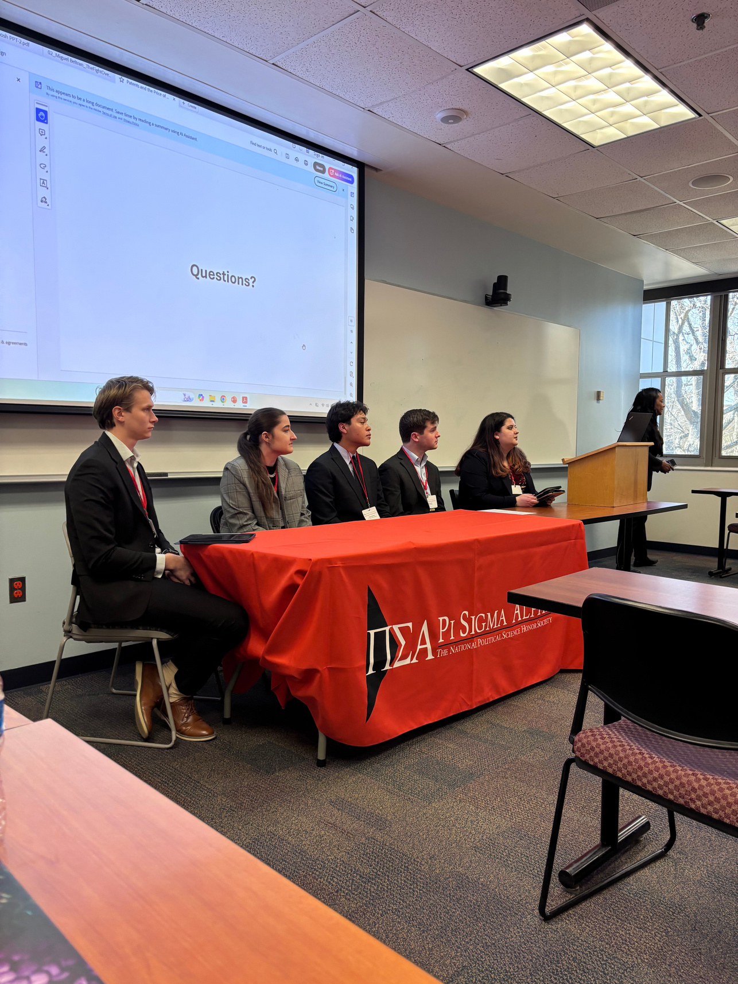
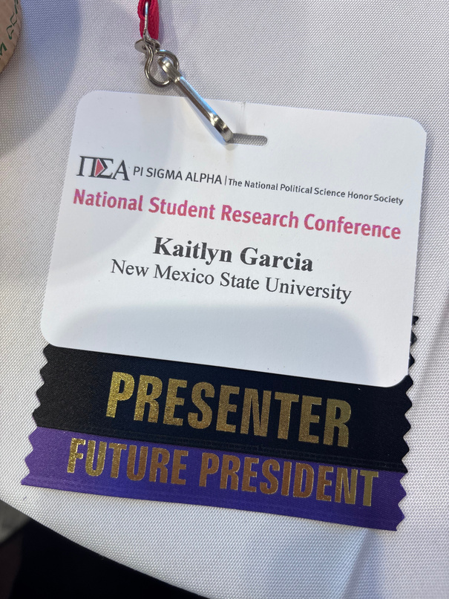
  PSA ETA ETA CHAPTER
NMSU’s Pi Sigma Alpha Eta Eta Chapter is focused on promoting politics among the student body. Through our research opportunities, students can travel to Washington, D.C., and present their research on a national level. For many of our students, last year was the first time presenting research at a conference. This was a great opportunity for us to practice our research and public speaking skills. Unlike other research opportunities, we got to choose our research topics and learned more about what we are passionate about.

Slide 6

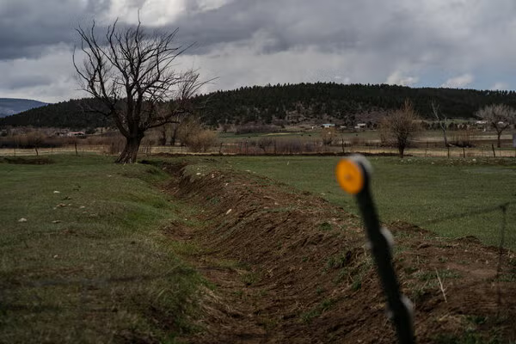
PROPOSALS DUE 10/31
New Mexico has relied on the Oil and Gas industry for nearly a century. Yet, it is still consistently one of the poorest states with an above national average poverty rate. Thus, for my research this year, I want to research why, even with the giants of industry investing heavily into local operations, it seems like the wealth has not been visible for many New Mexicans.
This year, with my research, I want to explore water scarcity in the American Southwest. Following the settlements in the 13-year-long Texas v. New Mexico case, how is New Mexico going to manage its water usage in the next decade? Considering the historical droughts in the Southwest, what impacts is this settlement going to bring forth? I want to address what impact this will have on New Mexico farming and the revenue that comes with agriculture.
P
VP
(New York Times, 2021
  RESEARCH FOR 2027 PSA NATIONAL STUDENT CONFERENCE

Slide 7
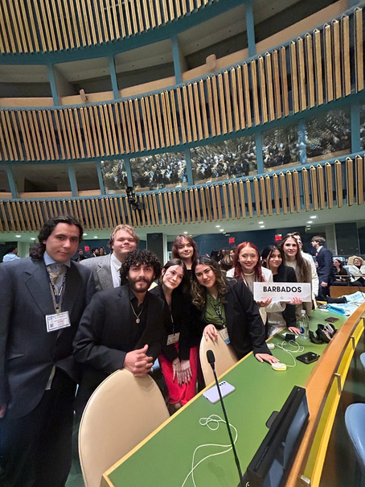
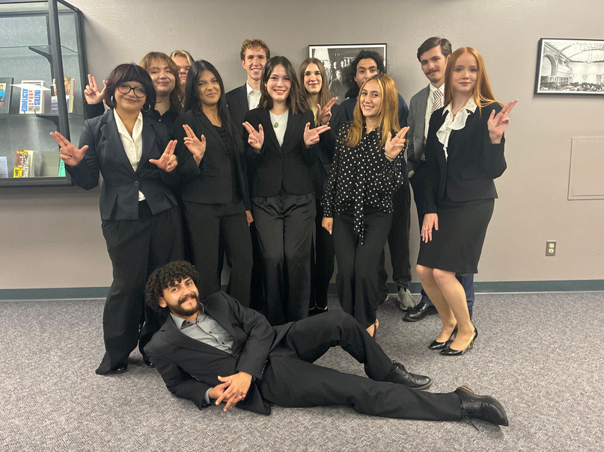
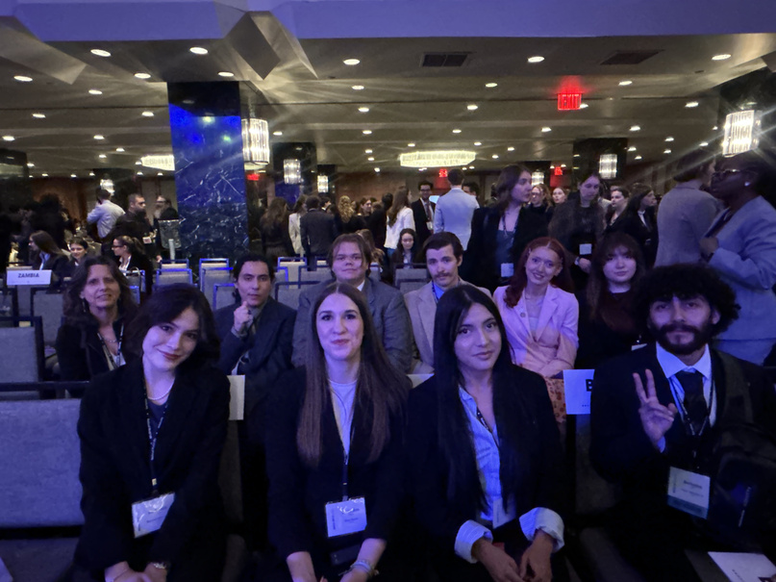
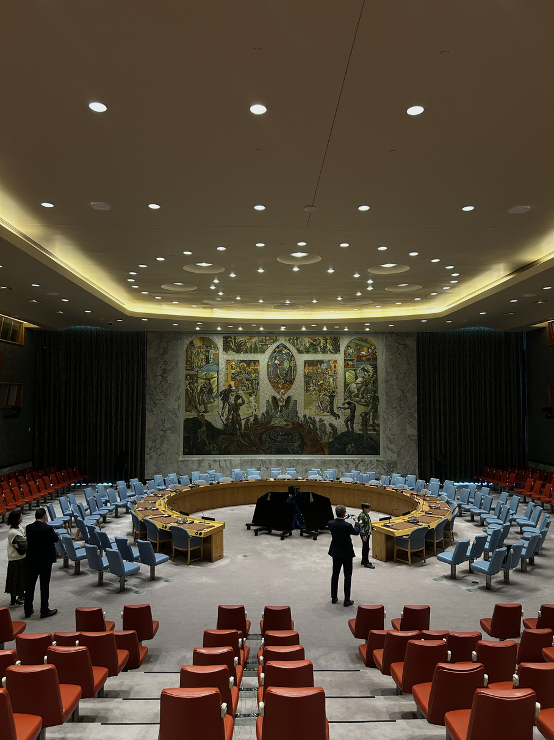
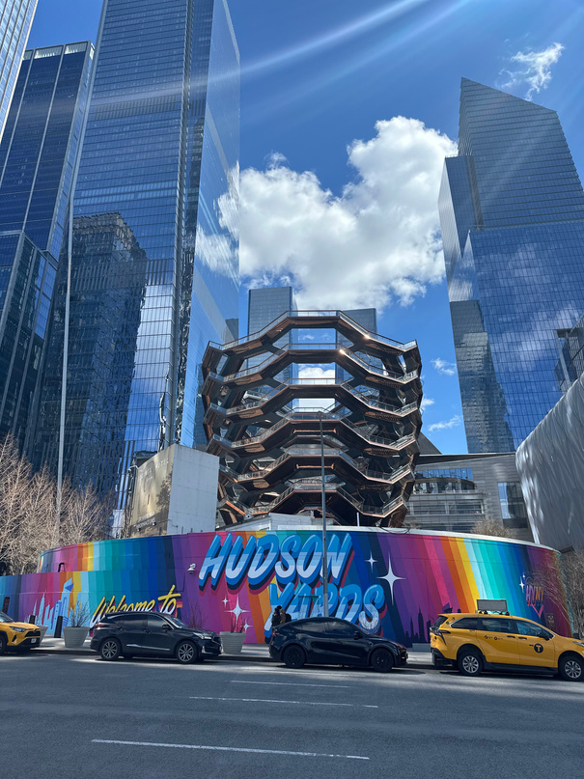
WHAT IS MODEL UNITED NATIONS?
  MUN is a simulation of the United Nations (UN).
  The UN aims to solve some of the greatest issues in the world through discussion and negotiation.
  Diplomacy is the foundation
  Negotation vs. Debate
  Spring Conference in NYC, international travel, D.C. 2026
GA floor - UNHQ
MUN Team 26-27
NMUN NY 2026
Security Council
NMUN NY

Slide 8


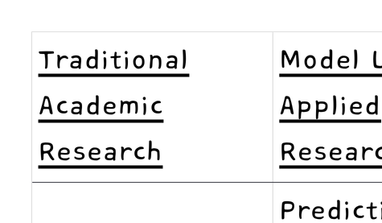

UN Priorities & Our Research
  Interpreting UN Actions and Resolutions
  Dealing with biased information and misinformation disseminated by governments
  Understanding the impact of forces like colonialism and capitalism
  Adapting under pressure
  What would our Member State do vs. our takeaway and learning of geopolitics
  Synthesis into a paper, speeches, and water-cooler talk
  Debate vs. Collaboration
  Research turns into a competive yet collaborative endeavor
able

Slide 9

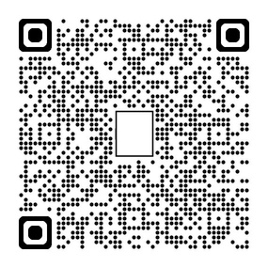

Learn More About MUN!
^MUN INSTAGRAM^
^MUN 2026 ARTICLE^
^UN Short Video^

Slide 10
Some examples of current research
Seong Kang - Gun Violence as a “wicked problem”
Jeffery Williams - Civil rights and desegregation
Cory Sukala – Political theory, religion and cultural differences
Sabine Hirschauer – Security studies, memory, gender and German political history
Esther Korsah – Migration, borders and resilience

Slide 11
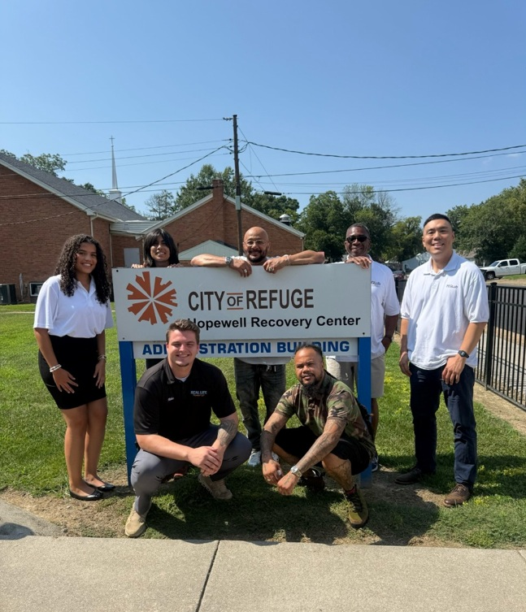

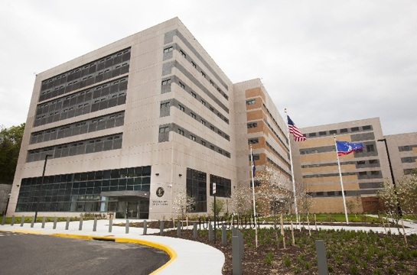
Gun Violence as a “Wicked Problem”
- Observations from the REAL LIFE Project SAF program
Professor Seong C. Kang, PhD, Associate Professor
Topic: Evaluation of REAL LIFE Project SAF
REAL LIFE?
  Nonprofit organization (Richmond, Hopewell, Petersburg, VA)
  Community services and programs
  Ex) former incarcerated, drug recovery, youths
Project SAF (Safe, Alive, and Free)?
  Community-based violence intervention program

Slide 12
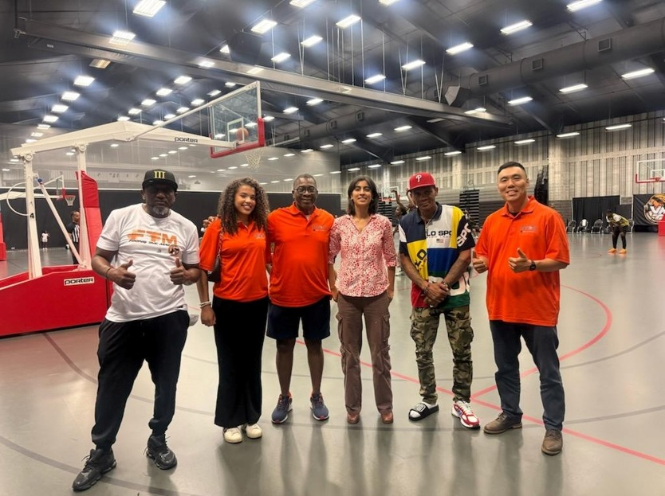


Research Design and Methods
Mixed-Method Approach
  Field observations and site visits
  Ride-alongs
  Interviews
  Surveys
Virginia (Hopewell, Petersburg, Richmond)
Participants:
  University of Virginia + NMSU faculty and staff
  REAL LIFE staff and life coaches
  Public and private partner organizations

Slide 13
Discussions for Policy
“Don’t just read a book; study the people that the book speaks about.”
Clients: Vulnerable, disadvantaged populations
Staff members (life coaches): Deeply committed individuals despite significant challenges with addressing community violence
Partnerships and collaboration: Other nonprofits, police, probation staff, schools, social service agencies, and other community organizations
4. Urban/community challenges
  Historic policies have generated infrastructure, social, personal inequities that are systemic and structural
  Resource awareness gap - many community members are not aware or do not utilize available services

Slide 14
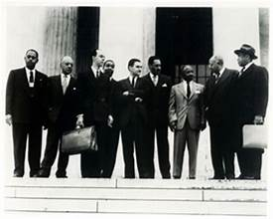
Dr. Jeffery Williams: Research
Historian Thomas Rosenblum stated the two rules of Jim Crow America were:
  1) Never admit a Black person can do anything better than a white person AND
  2) Never give a Black person the opportunity to prove rule one wrong.
Lawyers were among the only African Americans who engaged in direct competition with their white counterparts.
My research examines the lives of Jim Crow era African American lawyers to investigate how they challenged laws that assumed they were inferior by proving they were far from inferior with their courtroom exploits.

Slide 15
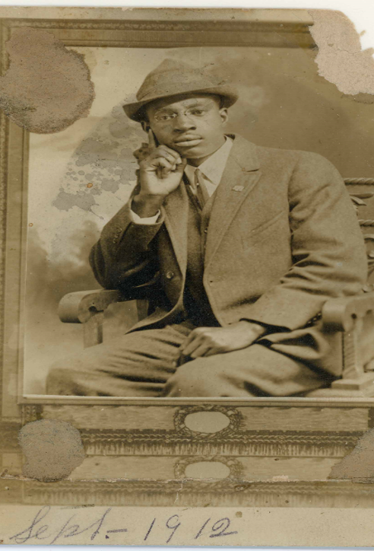
Book Project: Colored Lawyer, Topeka: The Legend of Elisha Scott
The project sees Kansas as a reflection of America because the state featured opportunities for African Americans such as college education but also had Jim Crow segregation laws.
Scott’s parents were born enslaved in Tennessee and migrated to Kansas in search of a new Canaan.
Scott was able to attend law school and become so well known to desperate African Americans throughout the country that he would receive letters addressed only “Colored Lawyer, Topeka.” Eventually his firm filed and argued Brown v. Board of Education in Topeka.
Sources:
  Case Files
  NAACP Papers at the Library of Congress
  Archives in Kansas
  Newspapers

Slide 16
Esther
Korsah
HELLO, I’M
The six program focus areas
My main interests
1
Cultural and linguistic translation, interpretation, literature, and heritage
2
Refugees, asylum-seekers, and migration
3
Transnational public policy and human rights
4
Environmental justice, landscape, archaeology, and heritage management
Second-year PhD student
5
Food security, water and energy security, human health, and sustainability
6
Power, inequality, and racial justice
Transborder and Global Human Dynamics, New Mexico State University
Background in Communication Studies
Notes:
About 60 seconds. Introduce yourself: Esther Korsah, second-year PhD student in Transborder and Global Human Dynamics (TBGD) at NMSU, with a background in Communication Studies. TBGD is an interdisciplinary program built on a federation of departments, including Anthropology, Government, and Languages and Linguistics, with related departments such as English, Gender and Sexuality Studies, Geography, History, Borderlands and Ethnic Studies, and Sociology. Students organize their work around six focus areas and choose two for their program of study. Name all six quickly, then point to the three highlighted ones as your main interests: refugees, asylum-seekers, and migration; transnational public policy and human rights; and power, inequality, and racial justice.

Slide 17
Migration, borders, and resilience
RESEARCH PROJECTS
DISSERTATION
MEDIA FRAMING
INTERNATIONAL STUDENTS
Navigating the Aftermath
Fentanyl in the Borderlands
To Cross a Border Is to Build a Border
How women migrants and unaccompanied minors at the U.S.–Mexico border find support after arrival, and the resilience they build when formal systems fall short.
How newspapers in El Paso and Ciudad Juárez frame the fentanyl crisis: do local border voices challenge national narratives of cartels and securitization, or echo them?
How border governance and administrative procedures produce embodied fear in legally documented international students, and how they build resilience.
Mixed methods · New Mexico and Texas
Critical discourse analysis
Qualitative · decolonial approach
Notes:
About 90 seconds, roughly 30 seconds each. Dissertation first: it asks what happens after arrival. Migration scholarship has covered why people migrate, the dangers of crossing, and structural barriers like legal violence, but far less on how women migrants and unaccompanied minors find and use support resources, and what resilience strategies they build when formal systems fall short. Mixed methods, with resource mapping and interviews in New Mexico and Texas. Second, Fentanyl in the Borderlands: a critical discourse analysis of how El Paso and Ciudad Juárez newspapers frame the crisis, and whether local proximity brings more humane coverage than the national securitized framing. Third, international students: even with lawful status, border governance and administrative procedures can produce embodied fear, which is the idea behind the title, "To cross a border is to build a border."

Slide 18
Health, harm reduction, and communication
RESEARCH PROJECTS, CONTINUED
EXPLORING
MATERNAL HEALTH COMMUNICATION
Opioid harm reduction and cancer prevention
Boundary Turbulence in the Diaspora
Existing research points to a correlation between substance use and certain cancers. This project asks how opioid-related harm reduction programs that already exist could be tailored toward cancer prevention.
How first-generation Ghanaian immigrant mothers navigate postpartum depression disclosure: whether, how, and with whom they talk about difficult feelings after childbirth.
Planned project · builds on my harm reduction and health communication work
Interviews · Communication Privacy Management theory
Notes:
About 90 seconds, roughly 45 seconds each. First, the side project: existing research highlights a correlation between substance use and certain cancers, so I want to explore how opioid-related harm reduction programs that already exist could be adapted toward cancer prevention. It draws on my work as a harm reduction specialist and health communicator. Second, the maternal health communication study: interviews with first-generation Ghanaian immigrant mothers about whether, how, and with whom they disclose postpartum depression, using Communication Privacy Management theory, with outcomes planned as a book chapter. Close by connecting everything: across all five projects, the question is how marginalized communities navigate systems that were not built for them, and how communication and policy can do better.

Slide 19
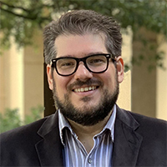
Dr. Cory Sukala – Political Theory,
Religion & Politics
My research explores how distinct political traditions are able to coexist and how competing social forces, such as political and religious authority, dictate our behavior. I am especially interested in what happens when different traditions, values, and understandings of the best life encounter one another in an increasingly interconnected world

Slide 20

Why It Matters
Political theory helps us understand real-world debates over issues such as freedom, rights, cultural conflict, and the limits of political authority. Examining competing political traditions reveals how our assumptions shape political conflict, policy debates, and the decisions that we make about how we should live our lives.
Dr. Cory Sukala
Recent Research
Contact Info
Rights Talk in a Genocide: Myanmar as a Lens for the Problem of Rights in Buddhist Political Thought
Can Mindful Politics Be Meaningful Politics? Socially Engaged Buddhism as a Political Project within a Liberal Political Order
The Adversary as a Political Hero: The Political Thought of Anton LaVey
sukala@nmsu.edu
Breland Hall, Room 342
Political Theory – Religion and Politics

Slide 21
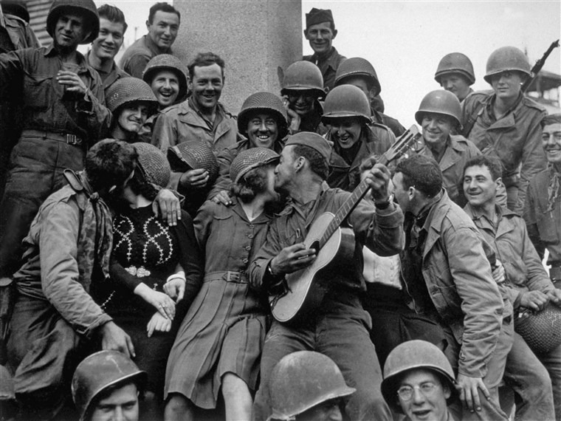
Dr. Sabine Hirschauer - Germany and its Mnemonical and Ontological Insecurity
Dr. Hirschauer’s current book project explores sexual violence, U.S. liberal militarism and national memory making during Germany’s occupation 1945-1955.
Ontological state security = ideational features of the state-self, created and maintained in part by biographical narratives (Steele 2008) that define “who we are” collectively narratives also dictate or inform “what to do” (Mälksoo, 2015, p. 221).
Mnemonical Security - subfield of ontological security studies; A state’s ontological security, emerging from a state’s biography is centrally linked to national memory.
Notes:
increasingly expansive sub-field of ontological security studies.

Slide 22
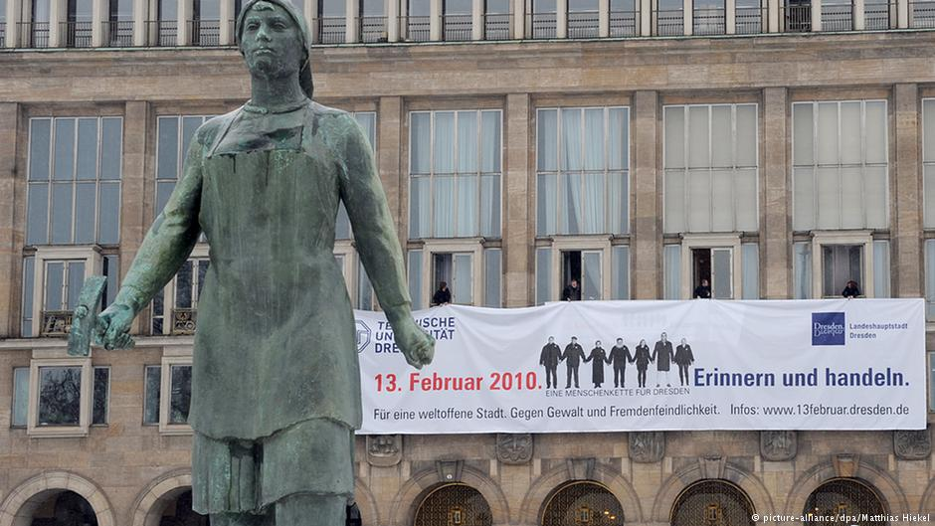
Research Questions
How do Western democracies (e.g. Germany and the U.S.) shape ontological, liberal mythscapes about themselves through deeply gendered, [racialized] mnemonical security interests?
How can national remembrances become the referent object of state
(in)security ?
How can a state’s mnemonical ontological security-seeking trigger repeated
cycles of memory ‘defenses’ (Maria Mälksoo, 2015) ?
Notes:
Not only: gendered Cold War politics of memory constitution, BUT to develop an analytical framework of

Slide 23

ARTICLE: Mnemonical (In)Security and Memory Defenses -
The Diary ‘Anonymous - A Woman in Berlin,’ Post-Conflict Sexual Violence and Germany’s Mnemopolitical Status-Seeking
Conceptualizes Germany’s mnemonical (in)security in the context of post-conflict large-scale sexual violence
Illustrates how Germany’s mnemopolitical status-seeking—the country’s use of its collective memory of guilt and shame, own victimhood and suffering used for specific strategic gains—became a referent object of mnemonical security through specific memory defenses during and after the Cold War
Analysis of public epitext material of two discursive time periods: the diary’s first 1959 publication in West Germany and then its 2003 re-publication in the reunited Federal Republic.
Epitext material—text that solely circulated outside of the diary’s actual publications (media reports, reviews, audio and visuals)
Notes:
increasingly expansive sub-field of ontological security studies.

Slide 24
Faculty research in the Department of Political Science, Public law and Administration
Check out the exciting research and publications of all our faculty at:
https://deptofgov.nmsu.edu/facultydirectory/faculty-profiles.html

Slide 25
Funded research
Discovery Scholars program ($750 awards for undergraduates)
Pursue a graduate programs (MA, MPA, Ph.D.) – start with Masters Accelerated Program (MAP)
Graduate Assistantships available for 2027-28
Ph.D. assistantships available for 2028-29
Fulbright Program:
https://fulbrightscholars.nmsu.edu/application.html

Slide 26
Thank you! Contact: Dr. Neil Harvey, Dept. Head, at nharvey@nmsu.edu

